Slide 1


AGRICULTURAL DATA ANALYSIS OF BANGLADESH IN TROPICAL AND TEMPERATE REGIONS
COURSE: Data Modeling and Implementation Techniques. NAME: MD AZMIR BHUIYAN STUDENT ID : 19985 PROFESSOR: Dr. Bhaskar, Vidhyacharan

Slide 2
PROJECT OVERVIEW
❖ INTRODUCTION
❖ Entity Relationship model
➢ ER Diagram
➢ ER Diagram description
❖ TRIANGLE relational database schemas.
❖ Queries
➢ Basic
➢ Intermediate Query (Inner, Right, Left, Full Outer and Cross join commands.)
➢ Advanced
❖ Mathematical Notation
➢ Basic
➢ Intermediate Query
➢ Advanced
❖ Conclusion

Slide 3


INTRODUCTION
● Importance of data in modern agriculture ● Role of SQL in managing and querying agricultural databases ● Benefits of analyzing agricultural data for optimizing farming practices and improving crop yields

Slide 4

What is Entity Relationship model?
● Entity-Relationship Diagram (ERD): A visual representation of the data structure for a system's database.
● Entities: These are objects or concepts that can have data stored about them.
● Relationships: They define how entities relate to each other and the nature of the connection.
● Attributes: Characteristics or properties of an entity.
● ERD Symbols: Include rectangles for entities, diamonds for relationships, and ovals for attributes.
● Cardinality: Specifies the numerical relationships between entities (one-to-one, one-to-many, many-to-many).
● Use Cases: ERDs are used for database design, to clarify system requirements, and to improve communication among stakeholders.

Slide 5
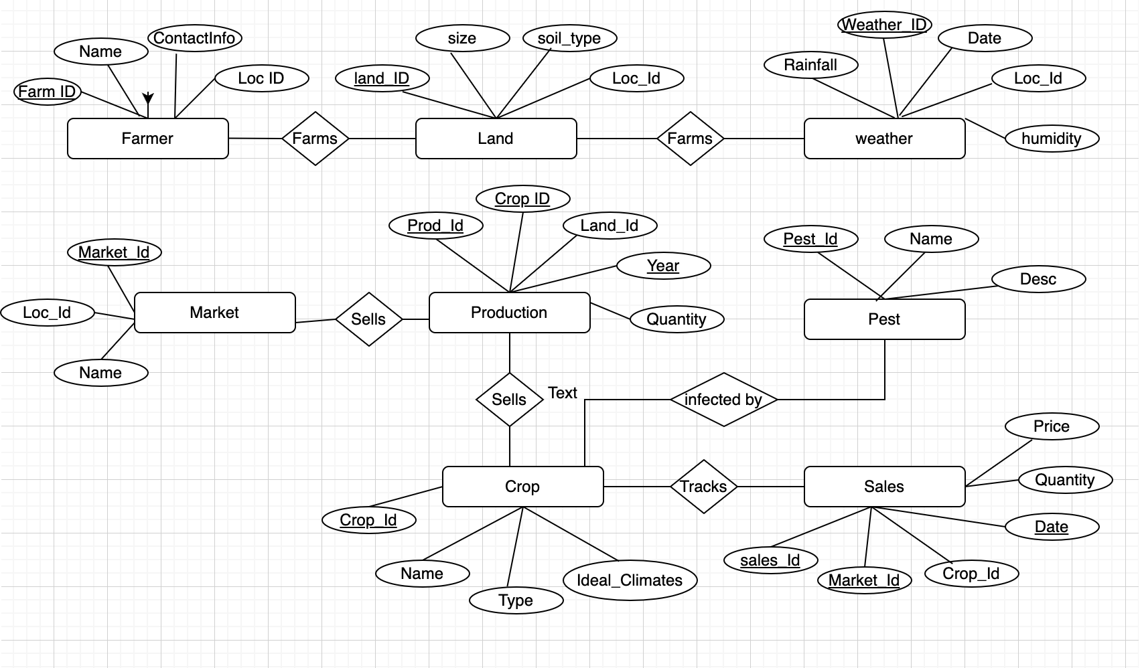
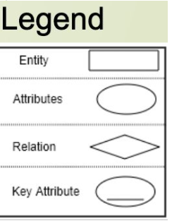
ER DIAGRAM
AGRICULTURAL DATA ANALYSIS

Slide 6
RELATIONSHIPS
Farmer and Land: A farmer can farm multiple lands, and a land can be farmed by multiple farmers (M:M)
Weather and Land: Weather conditions affect multiple lands (1:M)
Production and Market: Productions can be sold in multiple markets, and markets can sell multiple productions (M:M)
Land and Crop: A land can cultivate multiple crops, and a crop can be cultivated on multiple lands (M:M)
Crop and Pest: A crop can be infested by multiple pests, and a pest can infest multiple crops (M:M)
Crop and Sales: Sales data is tracked for each crop across different markets (M:M)

Slide 7
CREATE TABLE COMMANDS
CREATE TABLE Farmer (
Farmer_ID INT PRIMARY KEY,
Name VARCHAR(100),
Contact_Info VARCHAR(100),
Location_ID INT
);
CREATE TABLE Crop (
Crop_ID INT PRIMARY KEY,
Name VARCHAR(100),
Type VARCHAR(100),
Ideal_Climate VARCHAR(100)
);

Slide 8
CREATE TABLE COMMANDS
CREATE TABLE Land (
Land_ID INT PRIMARY KEY,
Size DECIMAL(10, 2),
Soil_Type VARCHAR(100),
Location_ID INT
); CREATE TABLE Production (
Production_ID INT PRIMARY KEY,
Crop_ID INT,
Land_ID INT,
Year INT,
Quantity DECIMAL(10, 2),
FOREIGN KEY (Crop_ID) REFERENCES Crop(Crop_ID),
FOREIGN KEY (Land_ID) REFERENCES Land(Land_ID)
);

Slide 9
CREATE TABLE COMMANDS
CREATE TABLE Location (
Location_ID INT PRIMARY KEY,
Name VARCHAR(100)
);
CREATE TABLE Weather (
Weather_ID INT PRIMARY KEY,
Date DATE,
Location_ID INT,
Temperature DECIMAL(5, 2),
Rainfall DECIMAL(5, 2),
Humidity DECIMAL(5, 2),
FOREIGN KEY (Location_ID) REFERENCES Location(Location_ID)
);

Slide 10
CREATE TABLE COMMANDS
CREATE TABLE Market (
Market_ID INT PRIMARY KEY,
Name VARCHAR(100),
Location_ID INT
);
CREATE TABLE Sales (
Sales_ID INT PRIMARY KEY,
Market_ID INT,
Crop_ID INT,
Date DATE,
Quantity DECIMAL(10, 2),
Price DECIMAL(10, 2),
FOREIGN KEY (Market_ID) REFERENCES Market(Market_ID),
FOREIGN KEY (Crop_ID) REFERENCES Crop(Crop_ID)
); CREATE TABLE Pest (
Pest_ID INT PRIMARY KEY,
Name VARCHAR(100),
Description VARCHAR(255)
);

Slide 11
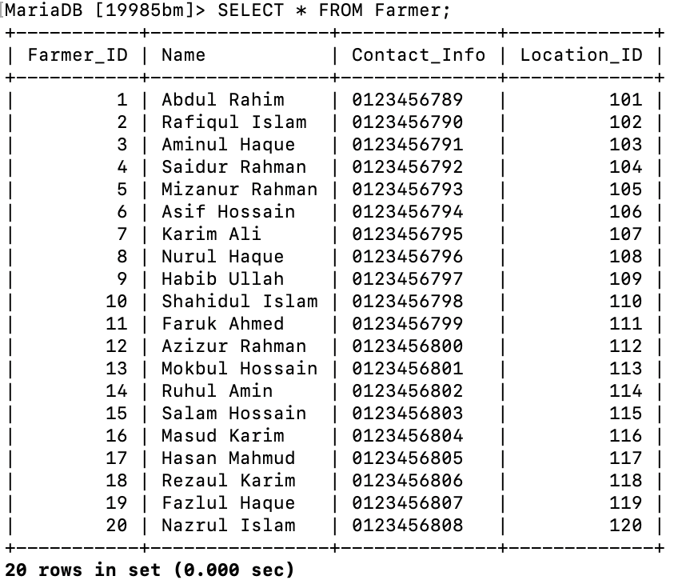
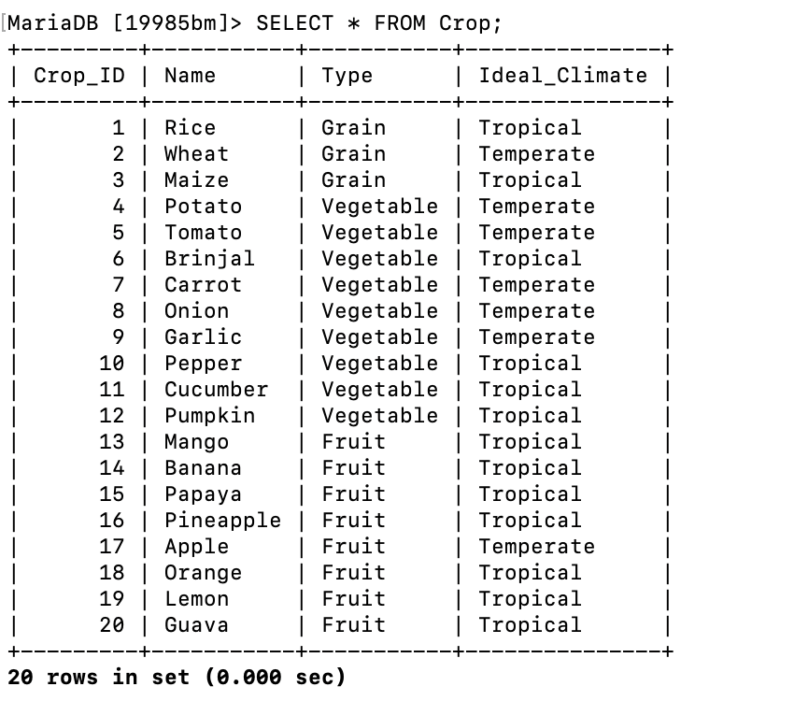
SCHEMAS(Farmer, Crop)

Slide 12
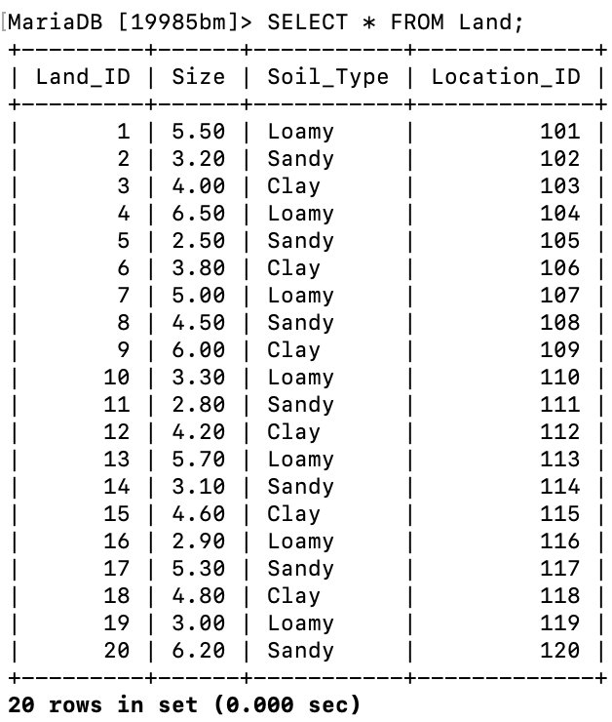
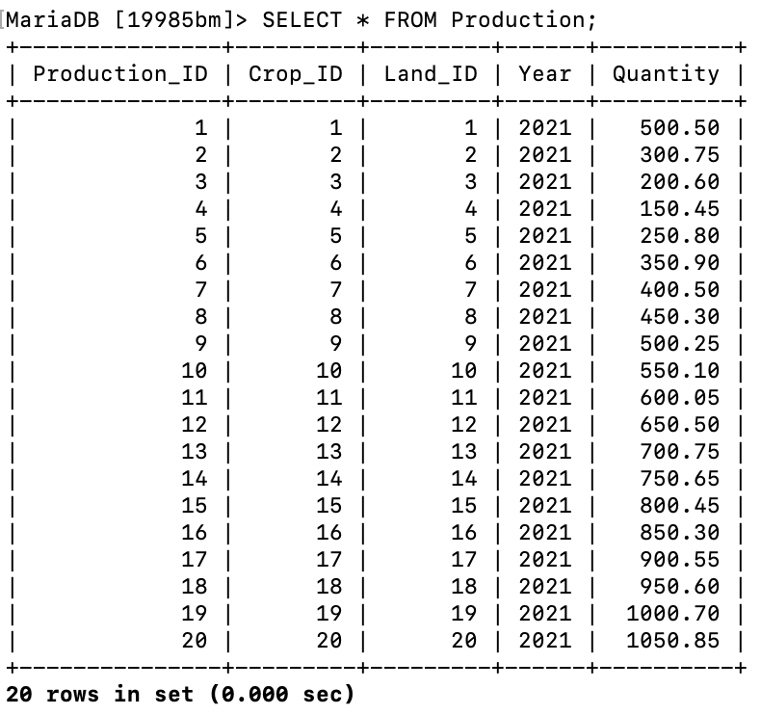
SHEMAS(Land, Production)

Slide 13
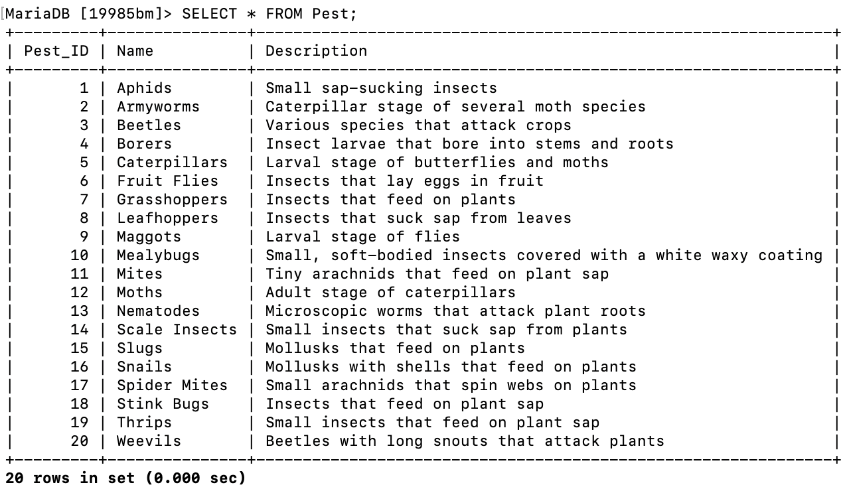
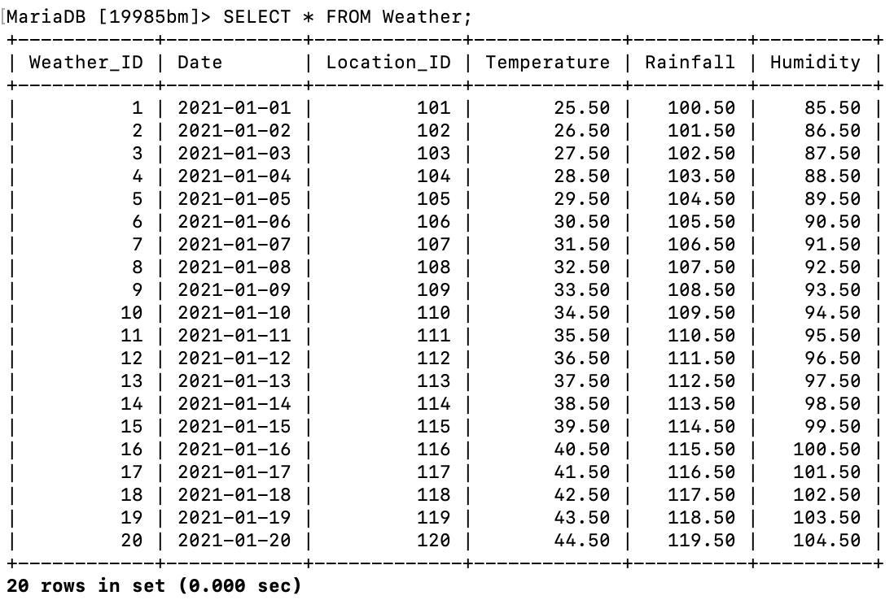
SCHEMAS(Pest, Weather)

Slide 14
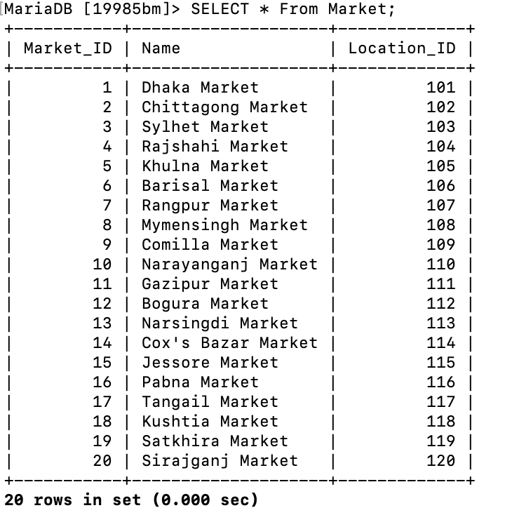
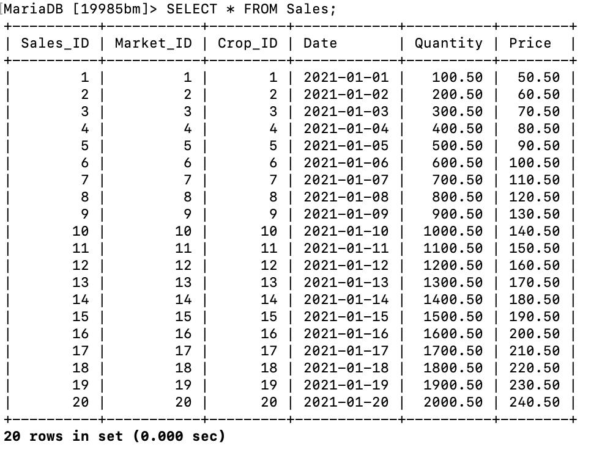
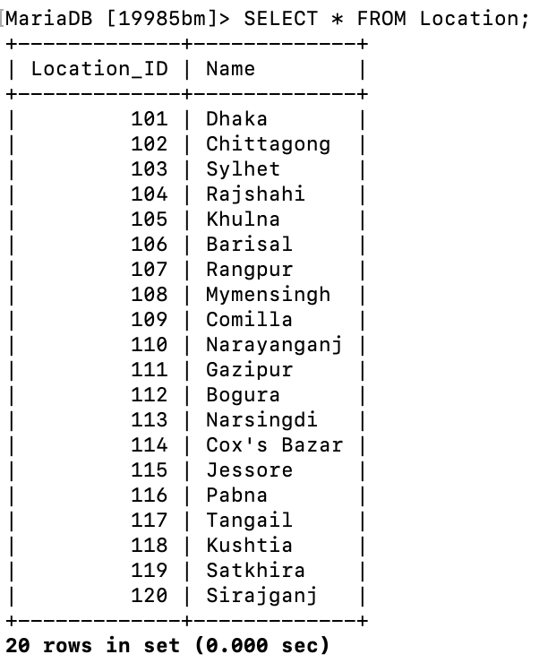
SCHEMAS(Market, Sales ,Location)

Slide 15
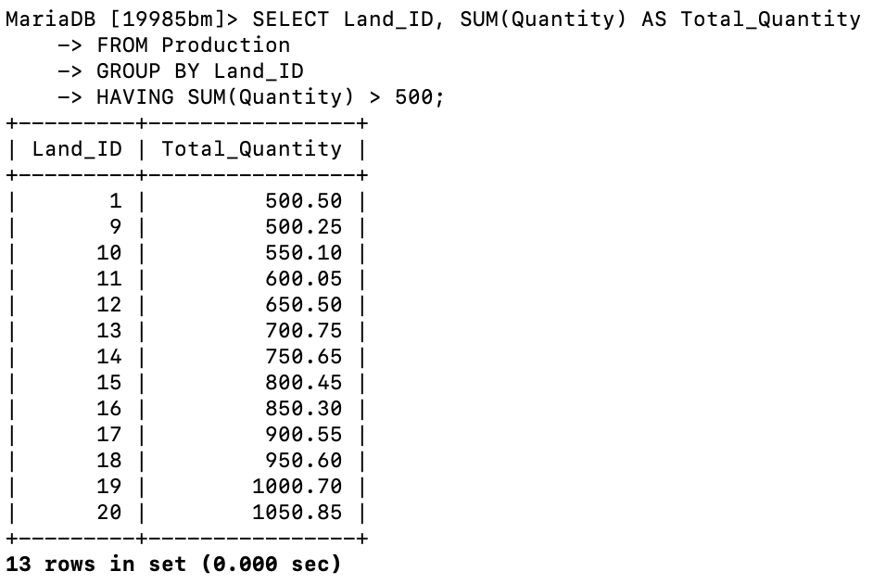
Basic Database queries HAVING QUERY:
Retrieves: Land_ID and total quantity produced on lands where total production exceeds 500 units. SELECT Land_ID, SUM(Quantity) AS Total_Quantity
FROM Production
GROUP BY Land_ID
HAVING SUM(Quantity) > 500;

Slide 16
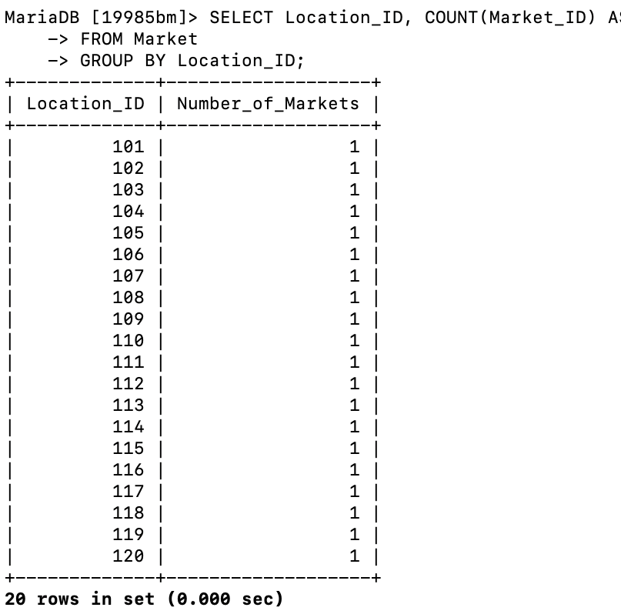
COUNT QUERY:
Retrieves: Location_ID and the count of markets in each location.
SELECT Location_ID, COUNT(Market_ID) AS Number_of_Markets
FROM Market
GROUP BY Location_ID;

Slide 17
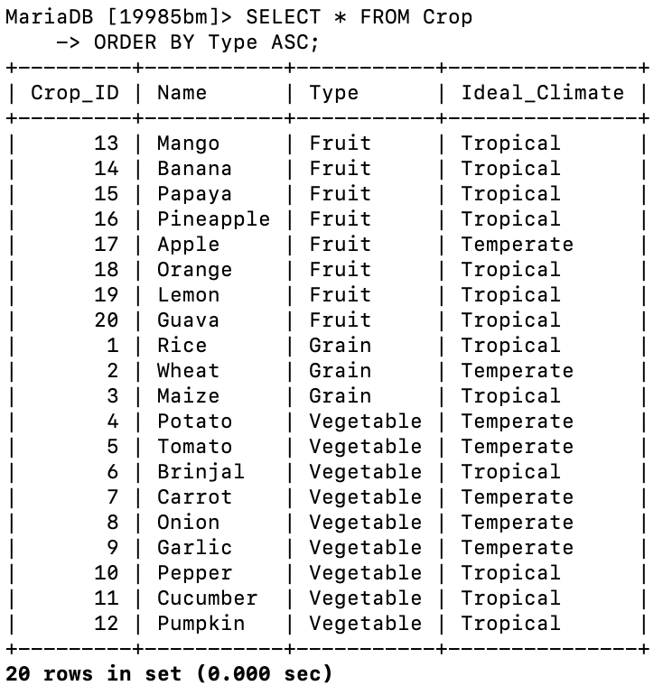
ORDER BY QUERY:
Retrieves: All crop details, ordered by crop type in ascending order. SELECT * FROM Crop
ORDER BY Type ASC;

Slide 18
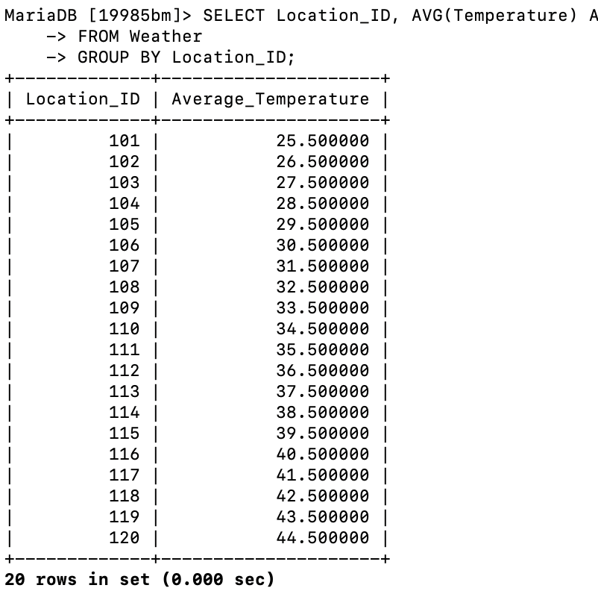
GROUP BY QUERY:
Retrieves: Location_ID and average temperature for each location. SELECT Location_ID, AVG(Temperature) AS Average_Temperature
FROM Weather
GROUP BY Location_ID;

Slide 19
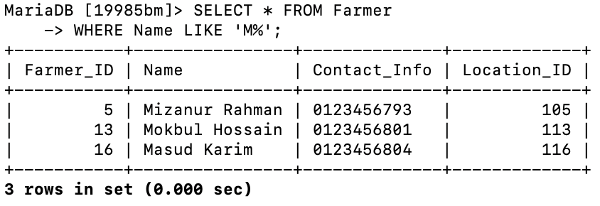
LIKE QUERY:
Retrieves: All details of farmers whose names start with 'M’. SELECT * FROM Farmer
WHERE Name LIKE 'M%';

Slide 20
Intermediate Database queries INNER JOIN Query:
Retrieves: Names of farmers and names of crops they have produced by joining the Farmer, Farmer_Land, Production, and Crop tables. SELECT Farmer.Name AS Farmer_Name, Crop.Name AS Crop_Name
FROM Farmer
INNER JOIN Farmer_Land ON Farmer.Farmer_ID = Farmer_Land.Farmer_ID
INNER JOIN Production ON Farmer_Land.Land_ID = Production.Land_ID
INNER JOIN Crop ON Production.Crop_ID = Crop.Crop_ID;

Slide 21
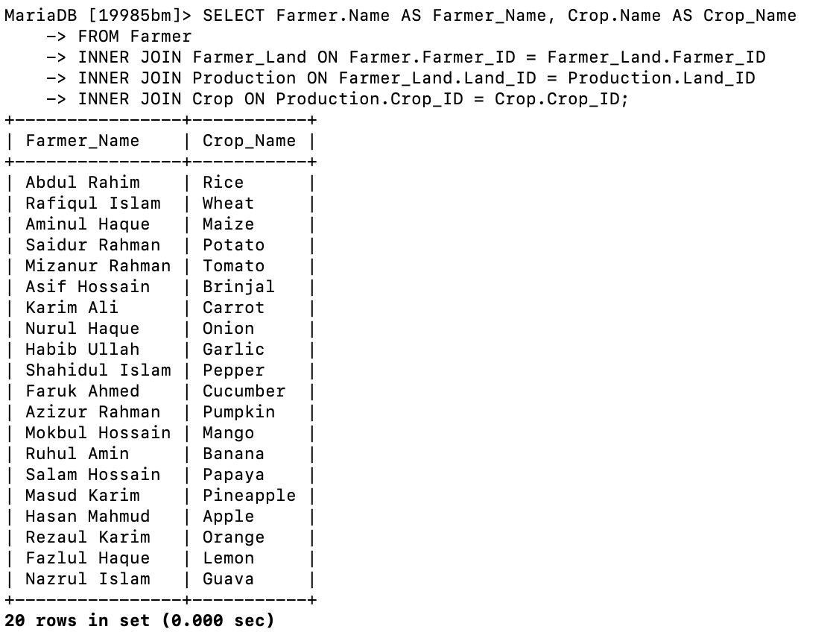

Slide 22
FULL OUTER JOIN
Retrieves: All market names and their corresponding location names, including markets or locations with no matching entry, by combining results from Market and Location tables. SELECT Market.Name AS Market_Name, Location.Name AS Location_Name
FROM Market
LEFT JOIN Location ON Market.Location_ID = Location.Location_ID
UNION
SELECT Market.Name AS Market_Name, Location.Name AS Location_Name
FROM Location
LEFT JOIN Market ON Location.Location_ID = Market.Location_ID;

Slide 23
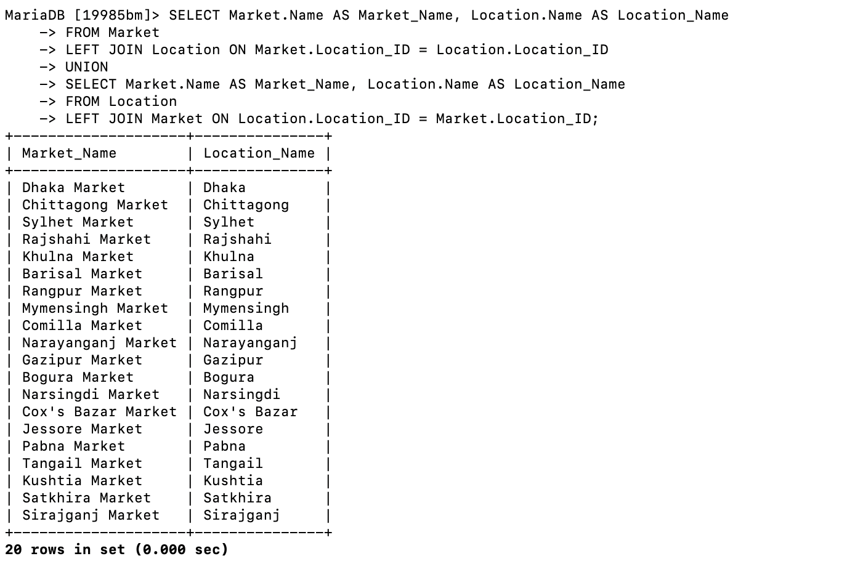

Slide 24
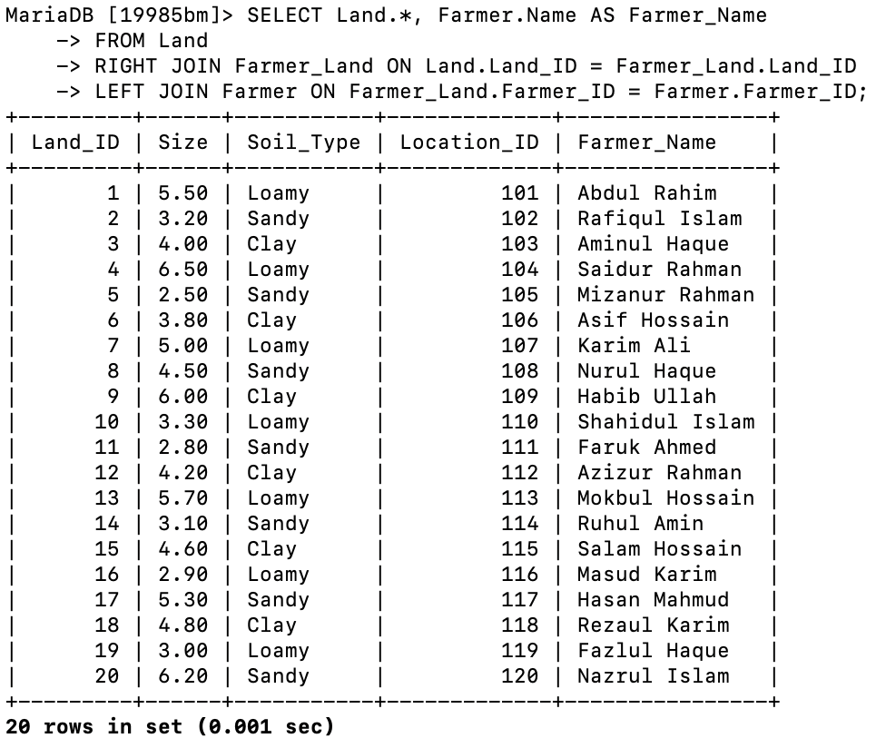
RIGHT JOIN
Retrieves: All lands and the names of farmers farming those lands, including lands that are not farmed by any farmer, by joining Land, Farmer_Land, and Farmer tables. SELECT Land.*, Farmer.Name AS Farmer_Name
FROM Land
RIGHT JOIN Farmer_Land ON Land.Land_ID = Farmer_Land.Land_ID
LEFT JOIN Farmer ON Farmer_Land.Farmer_ID = Farmer.Farmer_ID;

Slide 25
LEFT JOIN
Retrieves: All farmers and the total quantity of crops they have produced, including farmers with no production records, by joining Farmer, Farmer_Land, and Production tables and grouping the results by farmer name. SELECT Farmer.Name AS Farmer_Name, SUM(Production.Quantity) AS Total_Quantity
FROM Farmer
LEFT JOIN Farmer_Land ON Farmer.Farmer_ID = Farmer_Land.Farmer_ID
LEFT JOIN Production ON Farmer_Land.Land_ID = Production.Land_ID
GROUP BY Farmer.Name;

Slide 26
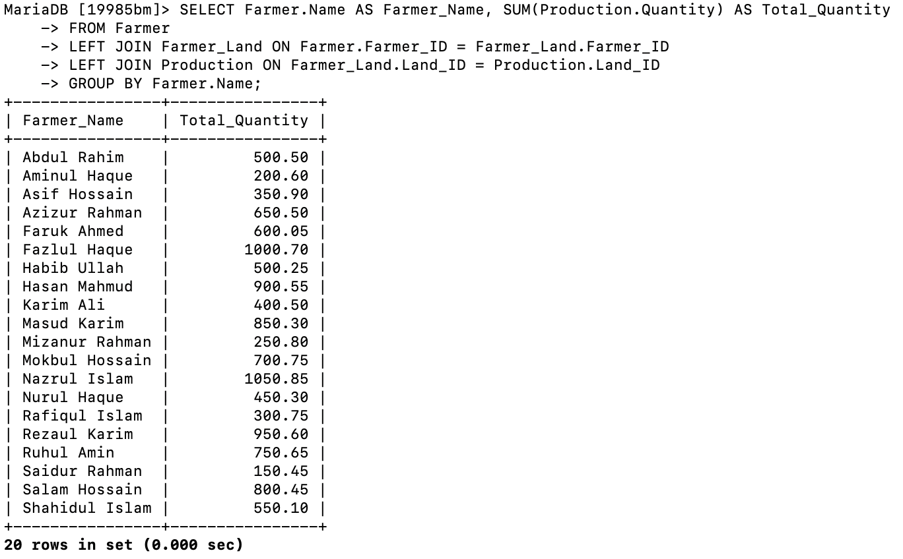

Slide 27
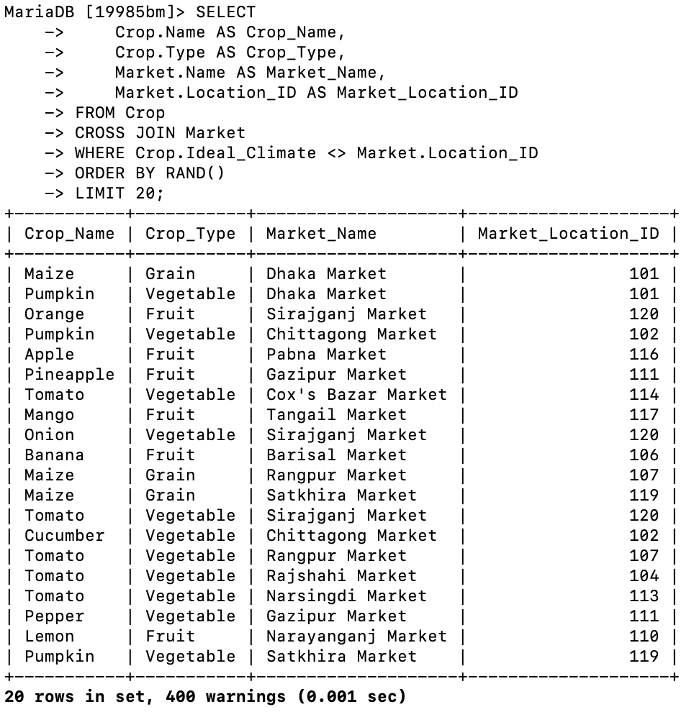
CROSS JOIN Query
Retrieve up to 10 different combinations of crop names, crop types, market names, and market locations. SELECT
Crop.Name AS Crop_Name,
Crop.Type AS Crop_Type,
Market.Name AS Market_Name,
Market.Location_ID AS Market_Location_ID
FROM Crop
CROSS JOIN Market
WHERE Crop.Ideal_Climate <> Market.Location_ID
ORDER BY RAND()
LIMIT 20;

Slide 28
ADVANCED QUERY NESTED INNER JOIN:
Retrieves: The average temperature for the locations where crops are produced and the total sales quantity for those crops by combining nested joins and a subquery.
SELECT Crop.Name AS Crop_Name, AVG(Weather.Temperature) AS Average_Temperature, SalesDetails.Total_Sales_Quantity
FROM Crop
INNER JOIN Production ON Crop.Crop_ID = Production.Crop_ID
INNER JOIN (
SELECT Land.Land_ID, Location_ID
FROM Land
) AS LandDetails ON Production.Land_ID = LandDetails.Land_ID
INNER JOIN Weather ON LandDetails.Location_ID = Weather.Location_ID
INNER JOIN (
SELECT Crop_ID, SUM(Quantity) AS Total_Sales_Quantity
FROM Sales
GROUP BY Crop_ID
) AS SalesDetails ON Crop.Crop_ID = SalesDetails.Crop_ID
GROUP BY Crop.Name;

Slide 29
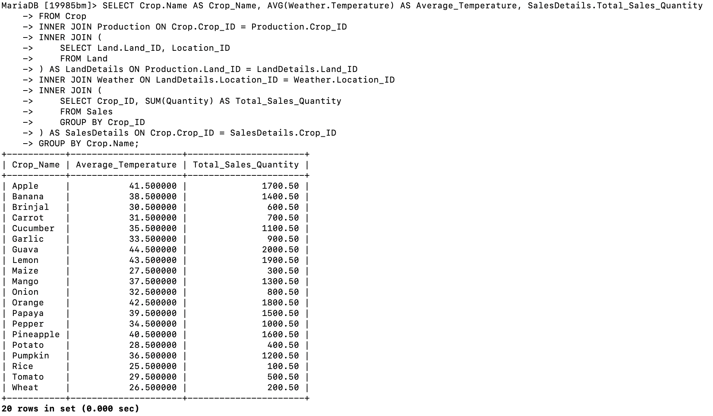

Slide 30
NESTED RIGHT JOIN (TWO WAYS)
Retrieves: All markets, the sales quantities, and their corresponding location names, including markets with no sales records by using nested right joins between Market, Sales, and Location tables. SELECT Market.*, SalesDetails.Total_Sales_Quantity, Location.Name AS Location_Name
FROM Market
RIGHT JOIN (
SELECT Sales.Market_ID, SUM(Sales.Quantity) AS Total_Sales_Quantity
FROM Sales
GROUP BY Sales.Market_ID
) AS SalesDetails ON Market.Market_ID = SalesDetails.Market_ID
RIGHT JOIN Location ON Market.Location_ID = Location.Location_ID;

Slide 31
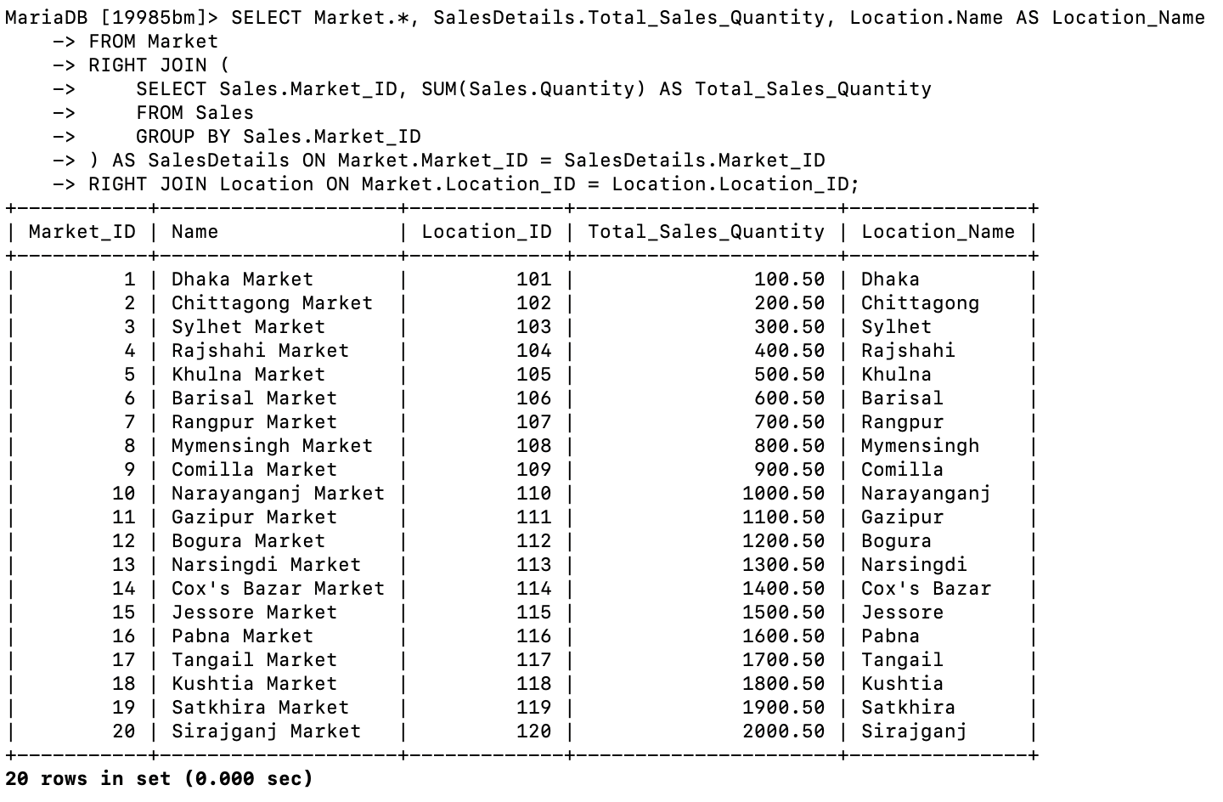

Slide 32
NESTED EQUI JOIN QUERY
Retrieves: The names of farmers, the names of crops they have produced, and the total sales quantity for each crop. This query uses nested equi-joins between Farmer, Farmer_Land, Production, Crop, and Sales tables to retrieve detailed production and sales information.
SELECT Farmer.Name AS Farmer_Name, Crop.Name AS Crop_Name, SalesDetails.Total_Sales_Quantity
FROM Farmer
JOIN (
SELECT Farmer_Land.Farmer_ID, Production.Crop_ID
FROM Farmer_Land
JOIN Production ON Farmer_Land.Land_ID = Production.Land_ID
) AS FarmerProduction ON Farmer.Farmer_ID = FarmerProduction.Farmer_ID
JOIN Crop ON FarmerProduction.Crop_ID = Crop.Crop_ID
JOIN (
SELECT Crop_ID, SUM(Quantity) AS Total_Sales_Quantity
FROM Sales
GROUP BY Crop_ID
) AS SalesDetails ON Crop.Crop_ID = SalesDetails.Crop_ID;

Slide 33
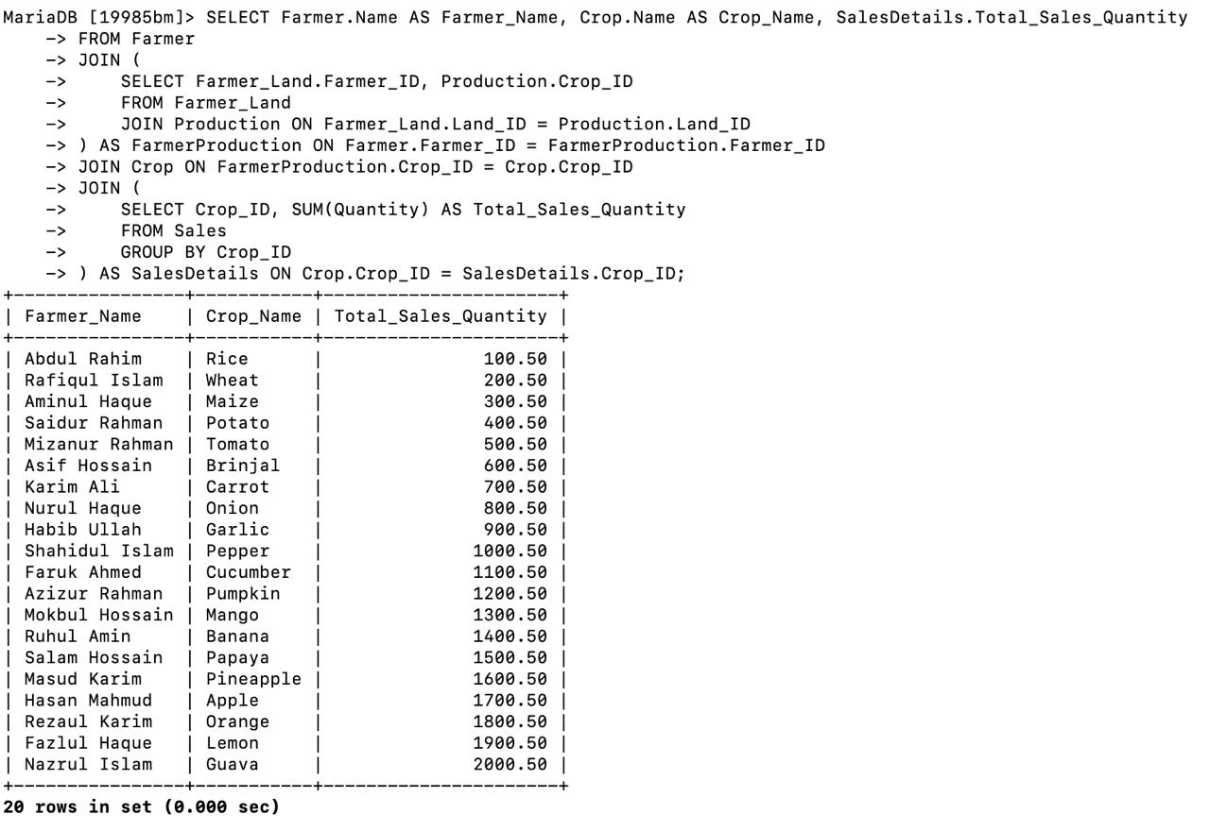

Slide 34
NESTED LEFT JOIN QUERY(Three-way): Retrieves: The names of farmers, the names of crops they have produced, the total sales quantity for each crop, and the average temperature of the locations where these crops are produced. This query includes farmers or crops with no sales records or weather data by using nested left joins.
SELECT Farmer.Name AS Farmer_Name, Crop.Name AS Crop_Name,
COALESCE(SalesDetails.Total_Sales_Quantity, 0) AS Total_Sales_Quantity,
COALESCE(WeatherDetails.Average_Temperature, 0) AS Average_Temperature
FROM Farmer
LEFT JOIN (
SELECT Farmer_Land.Farmer_ID, Production.Crop_ID, Production.Land_ID
FROM Farmer_Land
LEFT JOIN Production ON Farmer_Land.Land_ID = Production.Land_ID
) AS FarmerProduction ON Farmer.Farmer_ID = FarmerProduction.Farmer_ID
LEFT JOIN Crop ON FarmerProduction.Crop_ID = Crop.Crop_ID
LEFT JOIN (
SELECT Sales.Crop_ID, SUM(Sales.Quantity) AS Total_Sales_Quantity
FROM Sales
GROUP BY Sales.Crop_ID
) AS SalesDetails ON Crop.Crop_ID = SalesDetails.Crop_ID
LEFT JOIN (
SELECT Land.Land_ID, AVG(Weather.Temperature) AS Average_Temperature
FROM Land
LEFT JOIN Weather ON Land.Location_ID = Weather.Location_ID
GROUP BY Land.Land_ID
) AS WeatherDetails ON FarmerProduction.Land_ID = WeatherDetails.Land_ID;

Slide 35
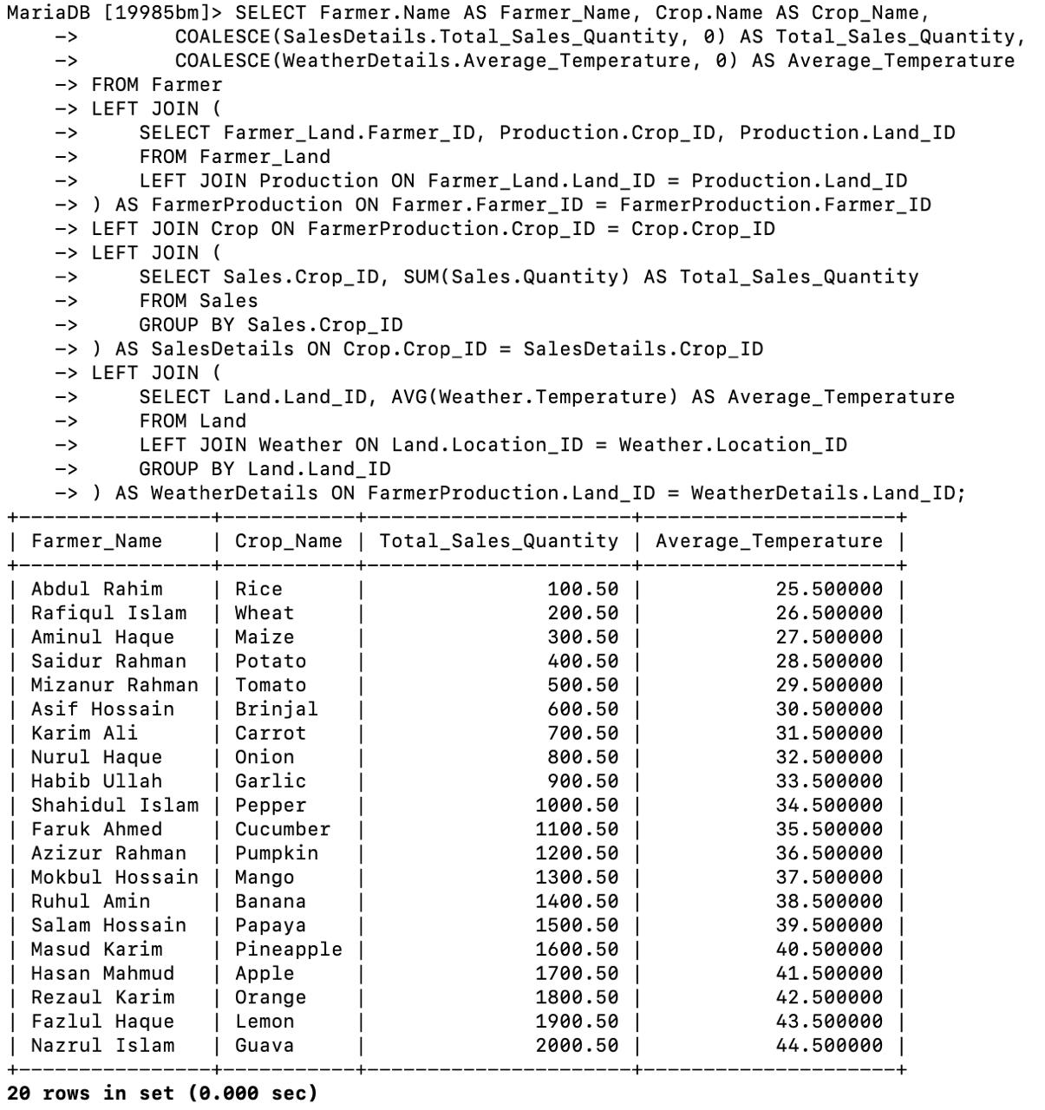

Slide 36
NESTED INNER-LEFT JOIN Retrieve the names of farmers, the names of crops they have produced, and the average temperature of the locations where these crops are produced, including crops with no corresponding weather data
SELECT Farmer.Name AS Farmer_Name, Crop.Name AS Crop_Name, COALESCE(WeatherDetails.Average_Temperature, 0) AS Average_Temperature
FROM Farmer
INNER JOIN (
SELECT Farmer_Land.Farmer_ID, Production.Crop_ID, Production.Land_ID
FROM Farmer_Land
INNER JOIN Production ON Farmer_Land.Land_ID = Production.Land_ID
) AS FarmerProduction ON Farmer.Farmer_ID = FarmerProduction.Farmer_ID
INNER JOIN Crop ON FarmerProduction.Crop_ID = Crop.Crop_ID
LEFT JOIN (
SELECT Land.Land_ID, AVG(Weather.Temperature) AS Average_Temperature
FROM Land
LEFT JOIN Weather ON Land.Location_ID = Weather.Location_ID
GROUP BY Land.Land_ID
) AS WeatherDetails ON FarmerProduction.Land_ID = WeatherDetails.Land_ID;

Slide 37
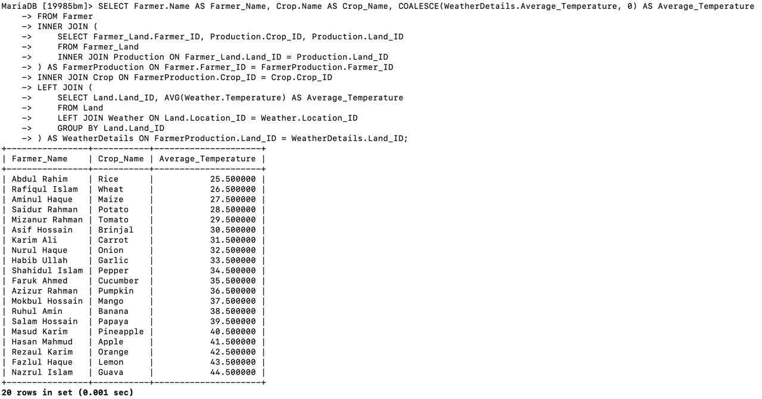

Slide 38
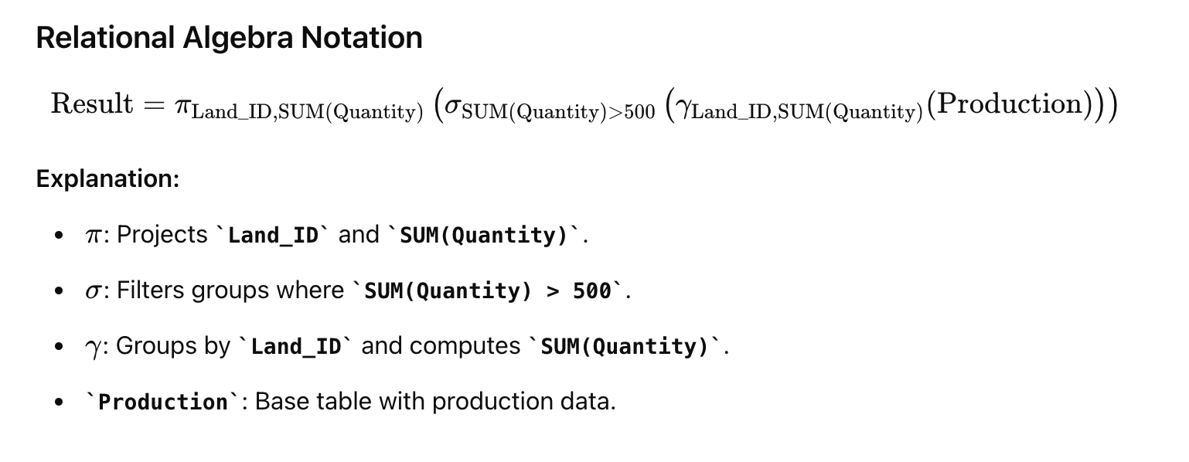
MATHEMATICAL NOTATION BASIC
Retrieves: Land_ID and total quantity produced on lands where total production exceeds 500 units. SELECT Land_ID, SUM(Quantity) AS Total_Quantity
FROM Production
GROUP BY Land_ID
HAVING SUM(Quantity) > 500;

Slide 39
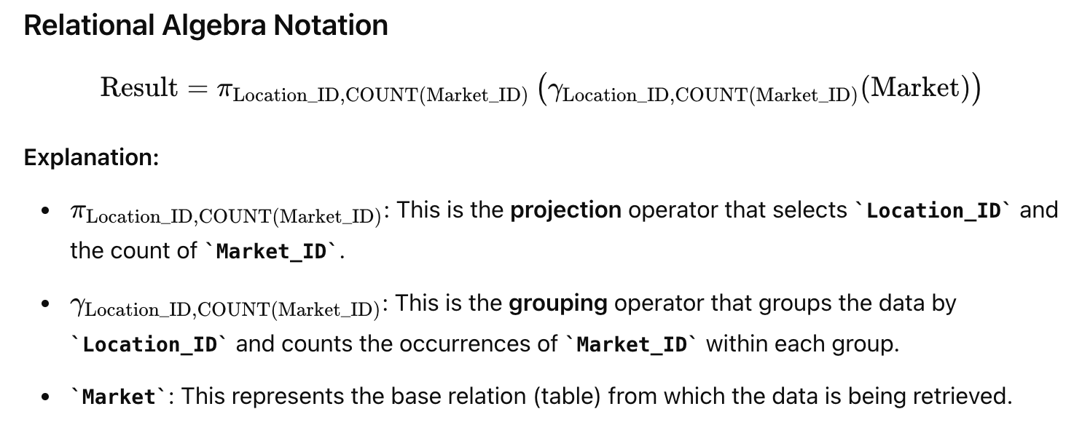
COUNT QUERY
Retrieves: Location_ID and the count of markets in each location.
SELECT Location_ID, COUNT(Market_ID) AS Number_of_Markets
FROM Market
GROUP BY Location_ID;

Slide 40
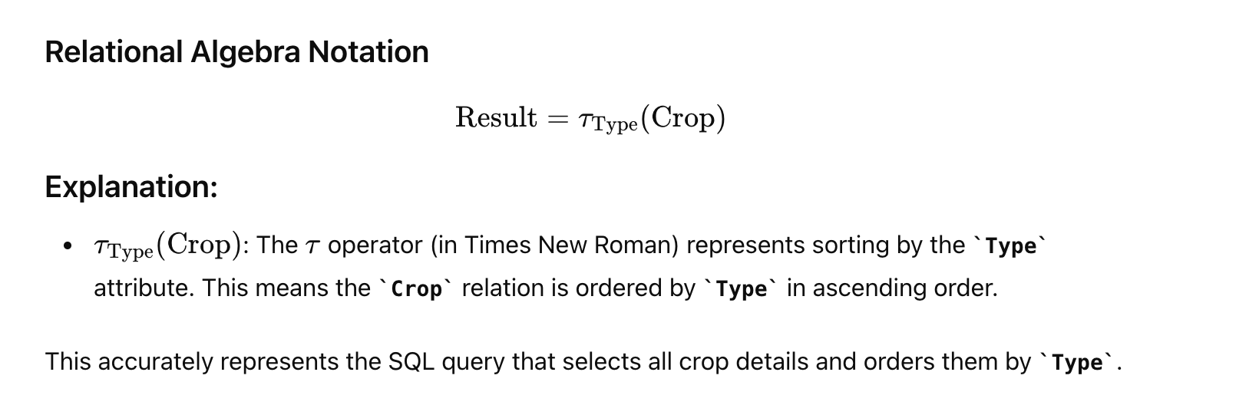
ORDER BY
Retrieves: All crop details, ordered by crop type in ascending order. SELECT * FROM Crop
ORDER BY Type ASC;

Slide 41
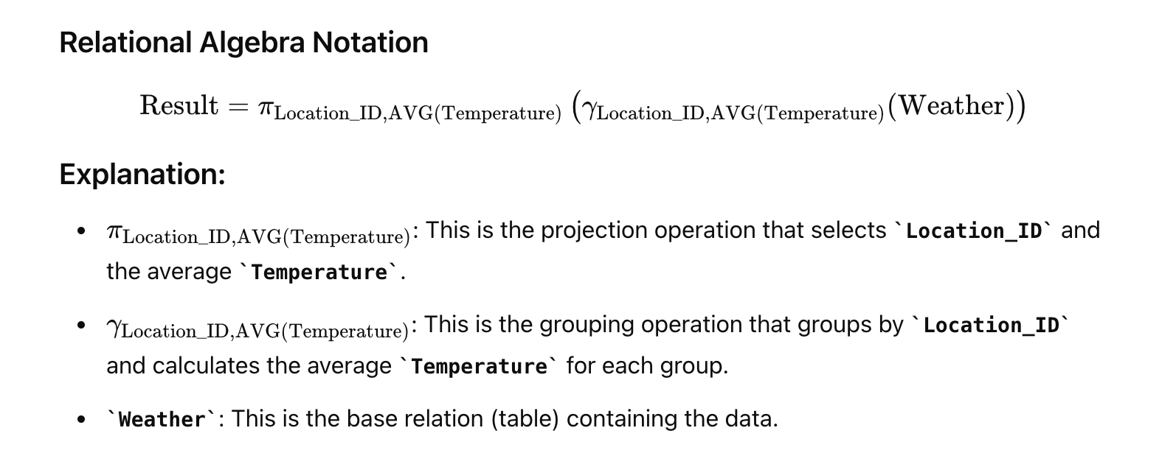
GROUP BY
Retrieves: Location_ID and average temperature for each location. SELECT Location_ID, AVG(Temperature) AS Average_Temperature
FROM Weather
GROUP BY Location_ID;

Slide 42
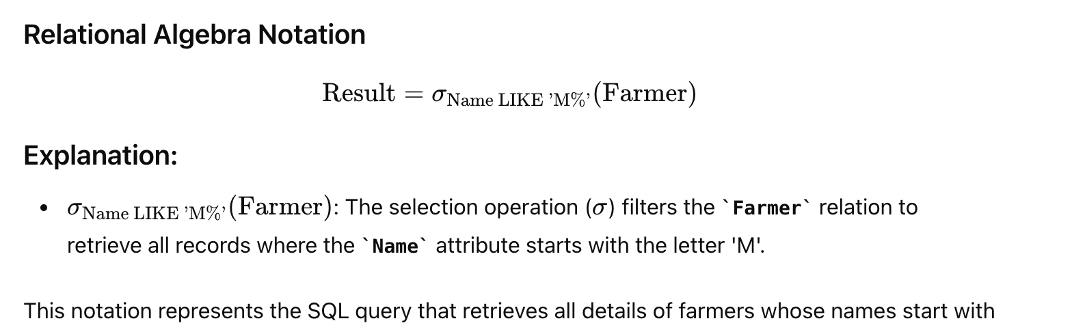
LIKE
Retrieves: All details of farmers whose names start with 'M’. SELECT * FROM Farmer
WHERE Name LIKE 'M%';

Slide 43
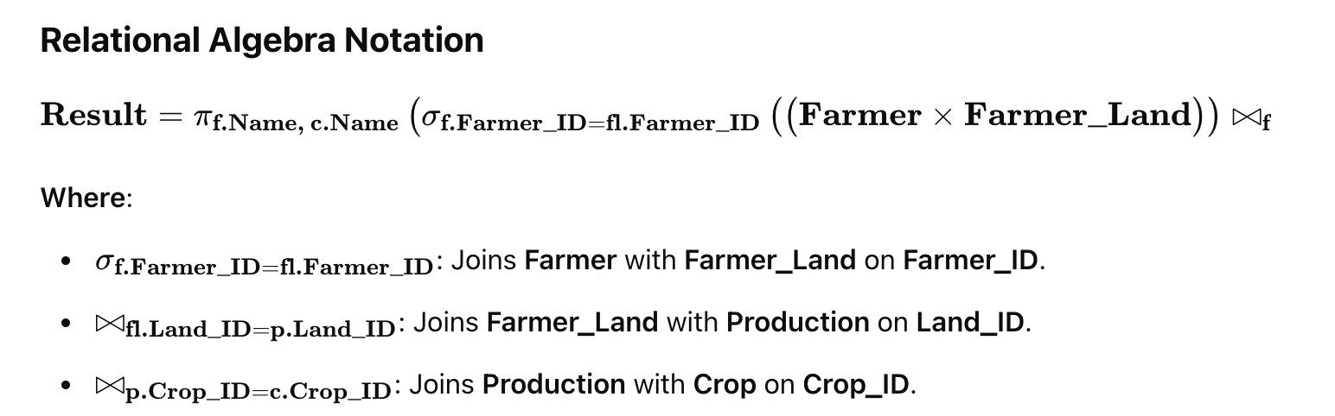
INTERMEDIATE INNER JOIN
Retrieves: Names of farmers and names of crops they have produced by joining the Farmer, Farmer_Land, Production, and Crop tables. SELECT Farmer.Name AS Farmer_Name, Crop.Name AS Crop_Name
FROM Farmer
INNER JOIN Farmer_Land ON Farmer.Farmer_ID = Farmer_Land.Farmer_ID
INNER JOIN Production ON Farmer_Land.Land_ID = Production.Land_ID
INNER JOIN Crop ON Production.Crop_ID = Crop.Crop_ID;

Slide 44
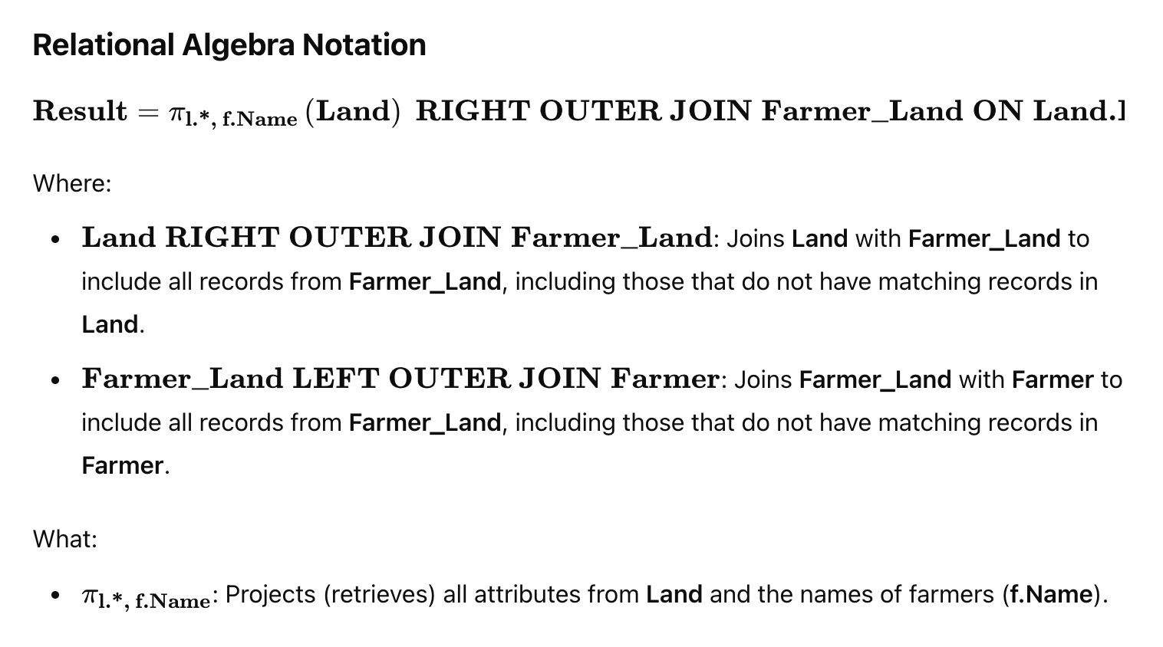
RIGHT JOIN
Retrieves: All lands and the names of farmers farming those lands, including lands that are not farmed by any farmer, by joining Land, Farmer_Land, and Farmer tables. SELECT Land.*, Farmer.Name AS Farmer_Name
FROM Land
RIGHT JOIN Farmer_Land ON Land.Land_ID = Farmer_Land.Land_ID
LEFT JOIN Farmer ON Farmer_Land.Farmer_ID = Farmer.Farmer_ID;

Slide 45
ADVANCED NESTED INNER JOIN:
Retrieves: The average temperature for the locations where crops are produced and the total sales quantity for those crops by combining nested joins and a subquery.
SELECT Crop.Name AS Crop_Name, AVG(Weather.Temperature) AS Average_Temperature, SalesDetails.Total_Sales_Quantity
FROM Crop
INNER JOIN Production ON Crop.Crop_ID = Production.Crop_ID
INNER JOIN (
SELECT Land.Land_ID, Location_ID
FROM Land
) AS LandDetails ON Production.Land_ID = LandDetails.Land_ID
INNER JOIN Weather ON LandDetails.Location_ID = Weather.Location_ID
INNER JOIN (
SELECT Crop_ID, SUM(Quantity) AS Total_Sales_Quantity
FROM Sales
GROUP BY Crop_ID
) AS SalesDetails ON Crop.Crop_ID = SalesDetails.Crop_ID
GROUP BY Crop.Name;

Slide 46
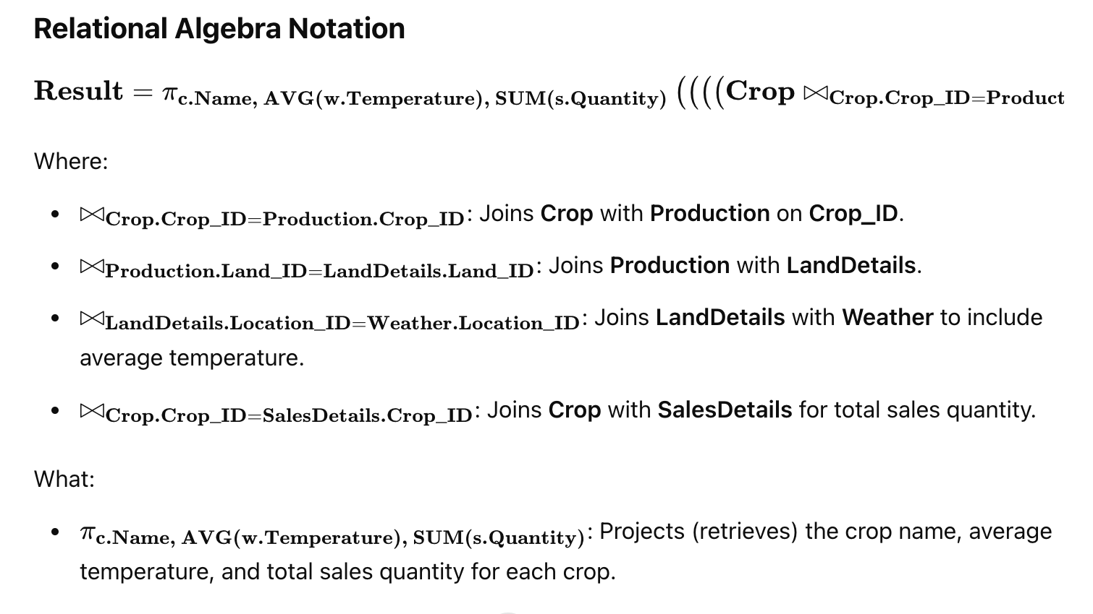

Slide 47
Conclusion
1)The project analyzes the impact of tropical and temperate climates on agriculture in Bangladesh. 2)Advanced SQL queries and Entity-Relationship models are used to organize and analyze complex data. 3)The study provides insights into crop production, pest management, and market dynamics. 4)The analysis helps in improving farming practices and decision-making through data-driven approaches.

Slide 48
REFERENCES
Doe, J. (2022). Impact of Weather on Crop Production in Bangladesh. Agricultural Studies, 45(3), 123-134. Retrieved from Agricultural Studies Journal • https://www.google.com/

